Slide 1





Slide 2

Elastic search
Week 4 of Code Star
Team 2's project
Team members:
Mahdi Jafari
Mohammad Sadeq Jabari
Mahdi Zahedi Yegeneh
Fatemeh Sayadzadeh

Slide 4







Slide 5






Slide 6









What is Elasticsearch??

Slide 8


Slide 9


Which companies use Elasticsearch?

Slide 10







Slide 11


Slide 12


Slide 13

Why is Elasticsearch popular?
- Open Source
- High speed
- Ability to search simultaneously across billions of documents
How?

Slide 15



Slide 16

What is an inverted index?

Slide 17
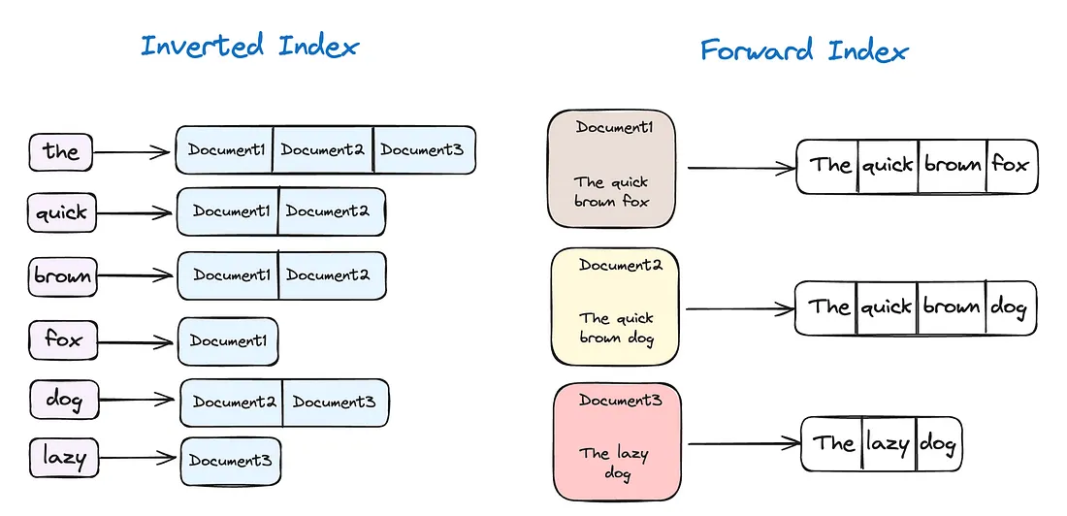
only suitable for small-scale scenarios
very time-consuming
efficient solution??

Slide 18
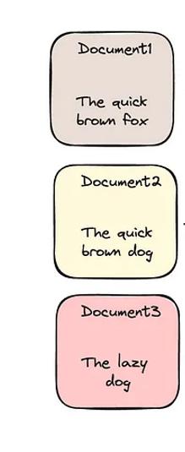
A better and faster solution!
Term Dictionary
Posting List
frequency

Slide 20


Slide 21

What is the relationship between inverted index and elastic search?
Provide fast and efficient
Extend and optimizes the basic concept
Handling large-scale data and complex queries

Slide 22
What are the uses of elastic search?
Text Search
Data Analysis
Monitoring and Management
Business Information Management
Support for AI and Machine Learning Systems
Recommendation Systems
Geographic and Mapping Systems
Document and Information Management
Big Data Analytics
Support for Complex and Custom Searches

Slide 23


Slide 24




Slide 25
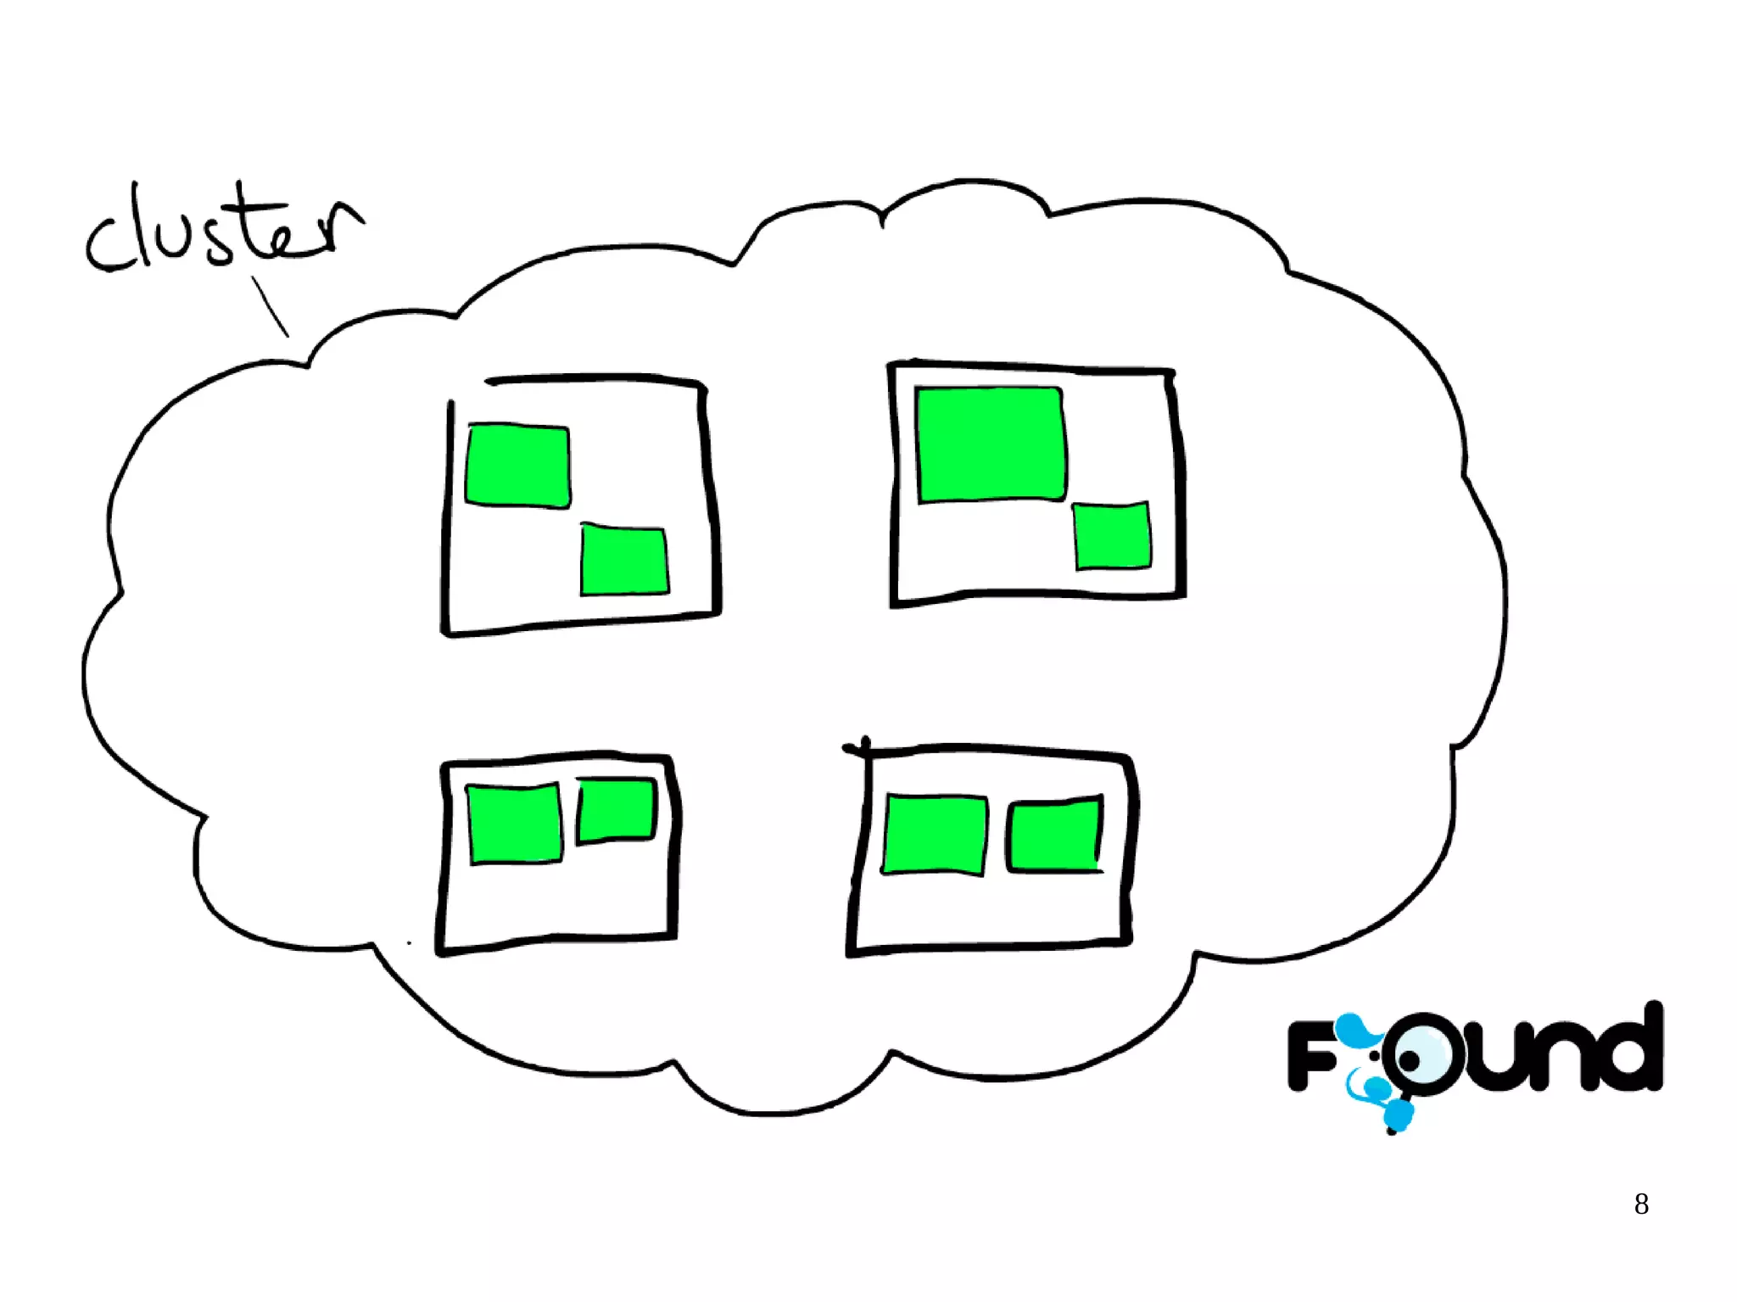












Cluster
cluster

Slide 26
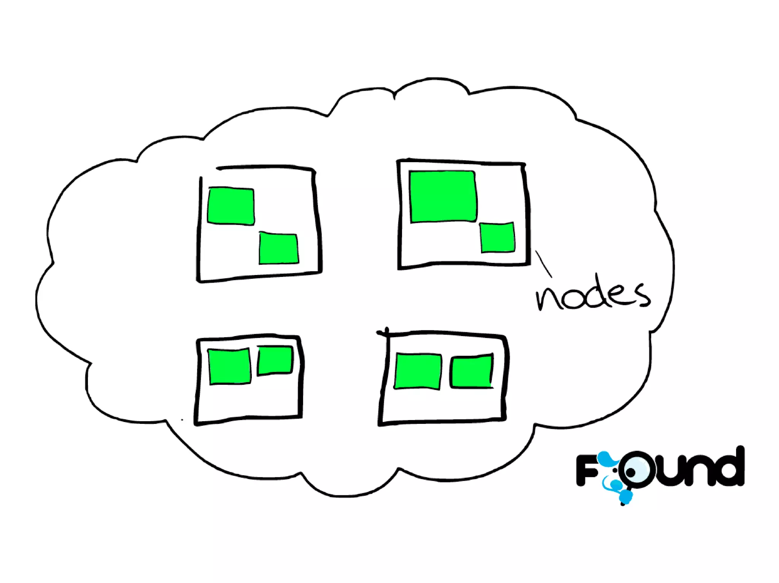













node
node

Slide 27
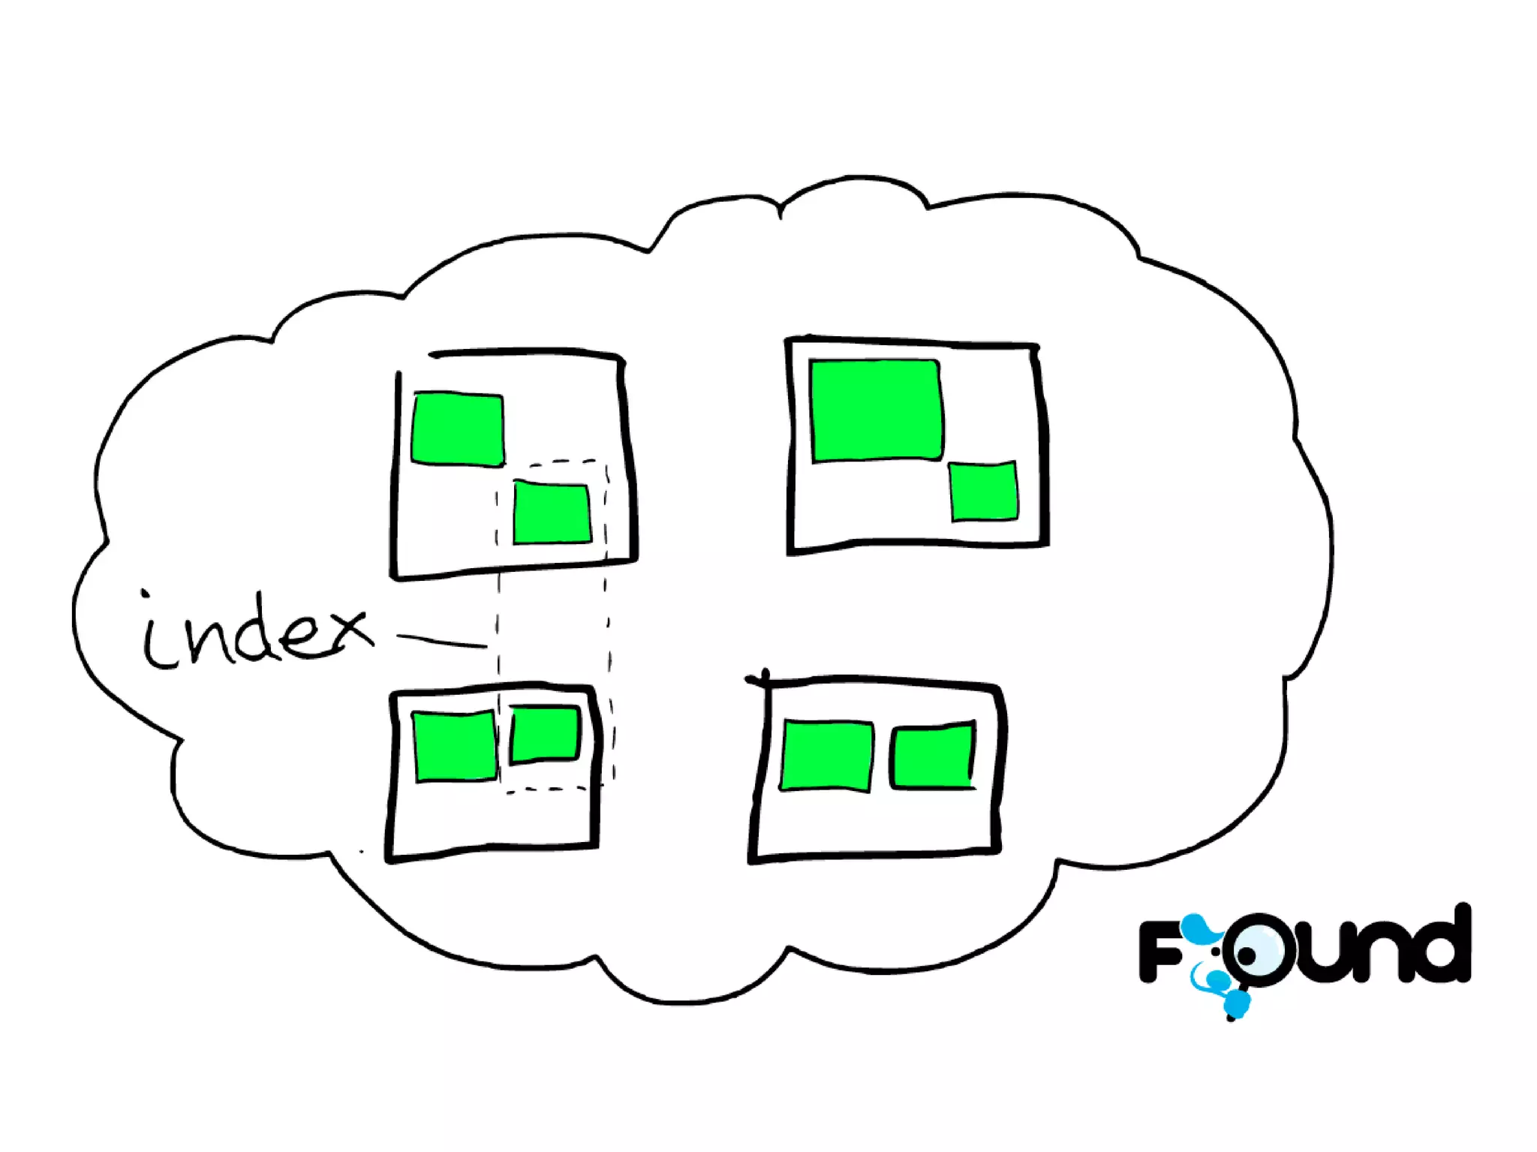


index
index

Slide 28
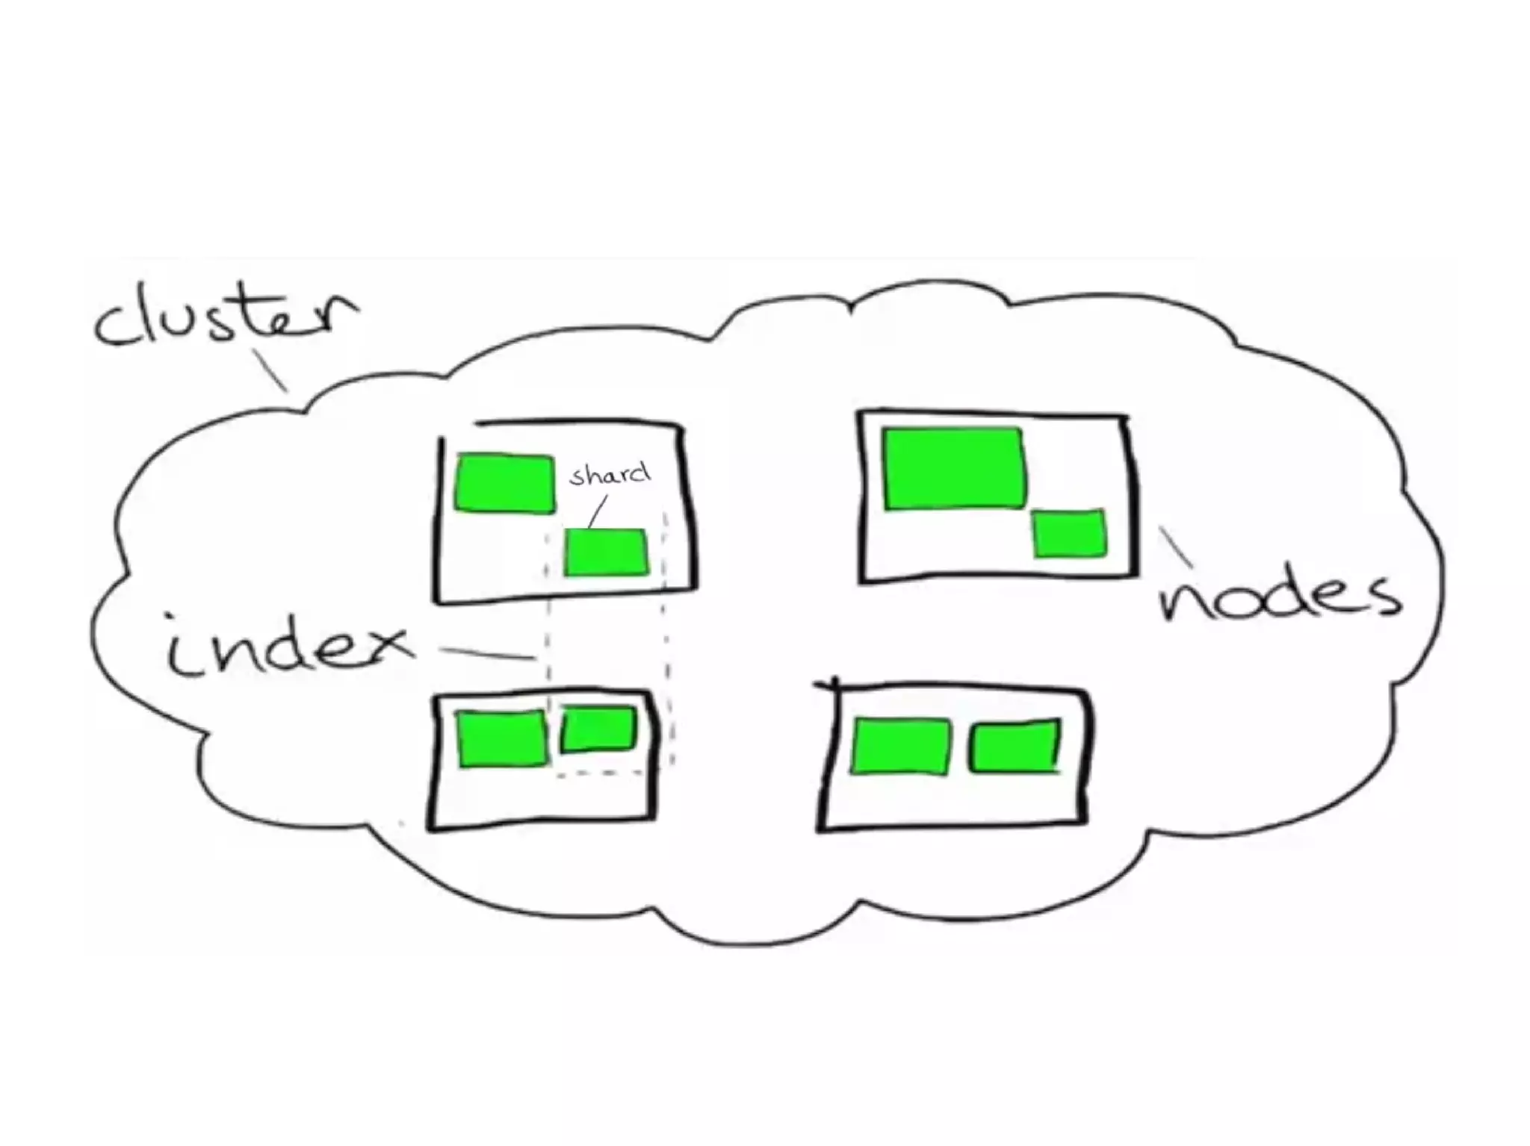


cluster
index
node
shard

Slide 29
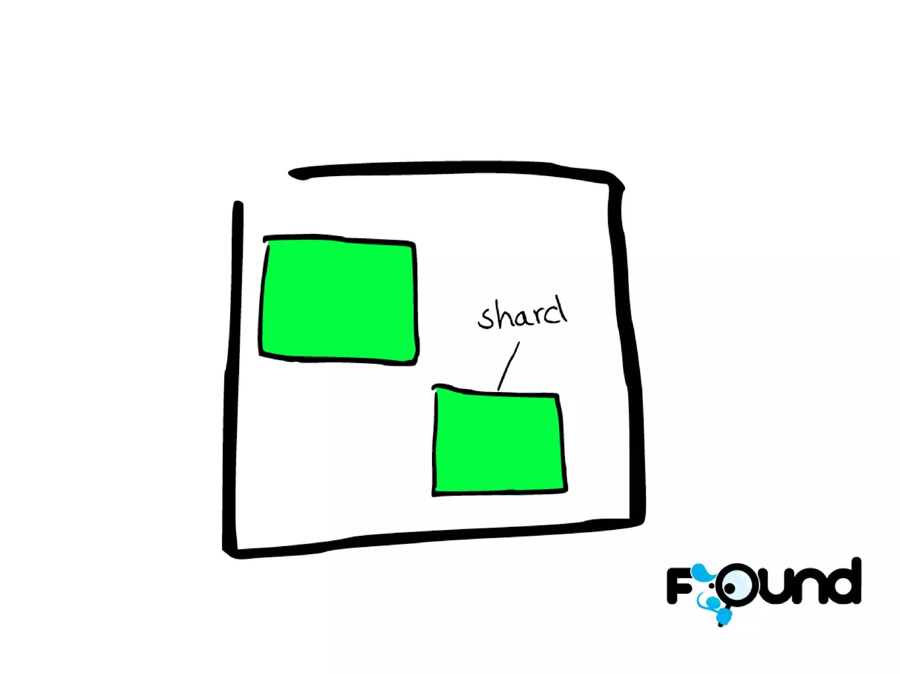



shard

Slide 30
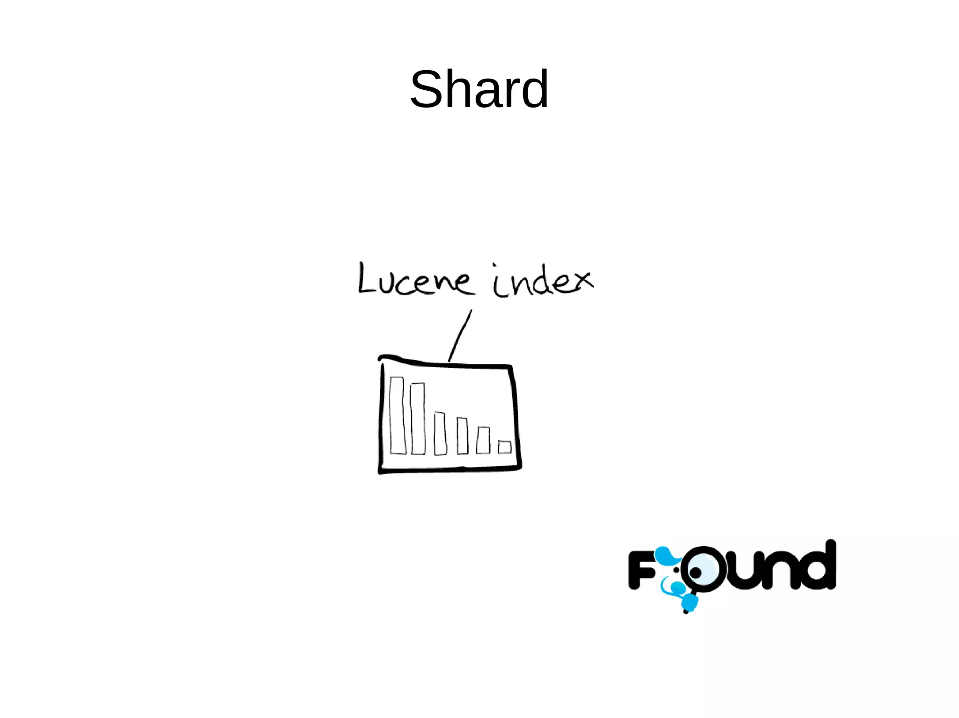






shard
shard

Slide 31
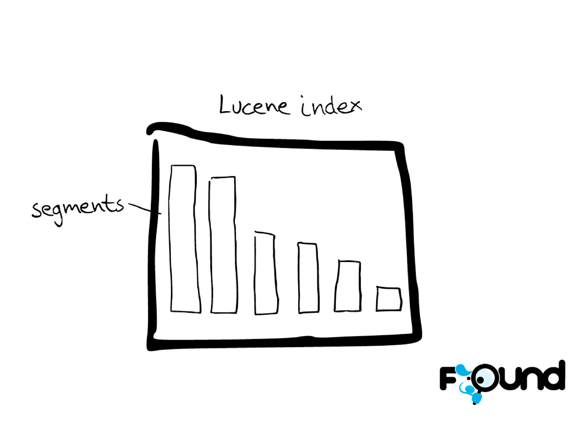


shard

Slide 32
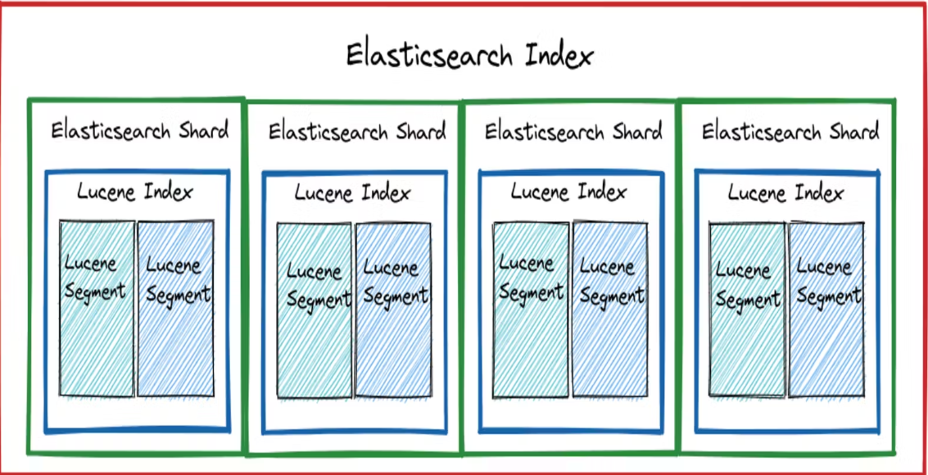

Slide 33
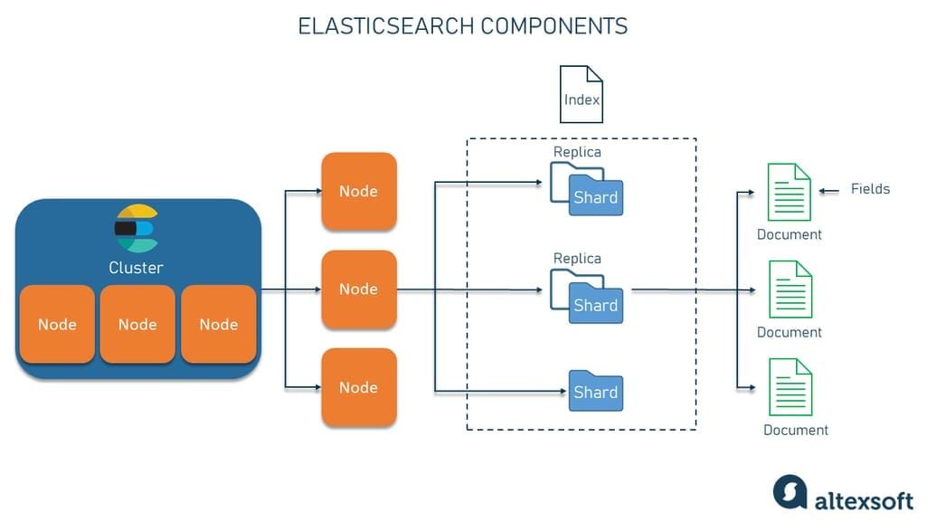
overview

Slide 34
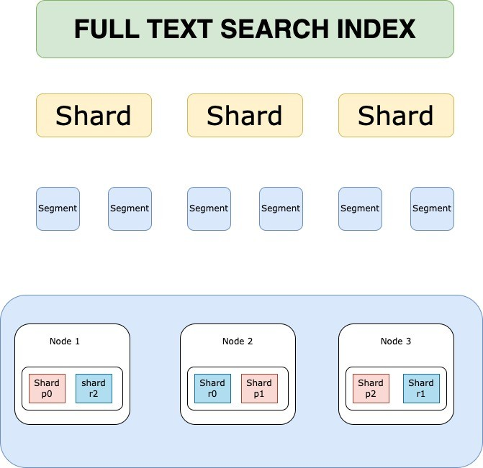
r-p shard

Slide 35

What happens when a query is searched?
Connection Node
Coordinating Node
Master Node
Ingest Node
Data Node
Machine Learning Node

Slide 36


Slide 38

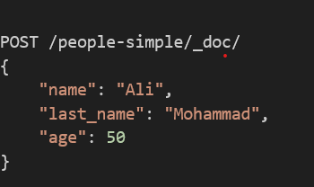
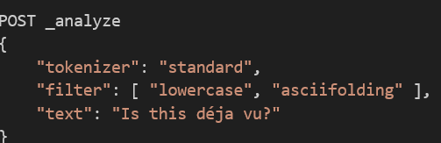
Posting data to index
Analyze

Slide 39
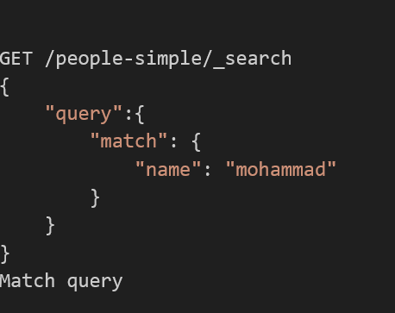
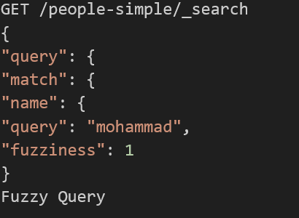
Match query
Fuzzy
query

Slide 40
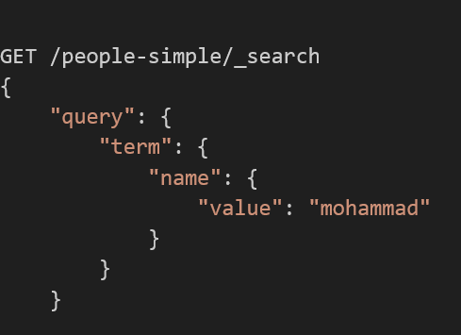
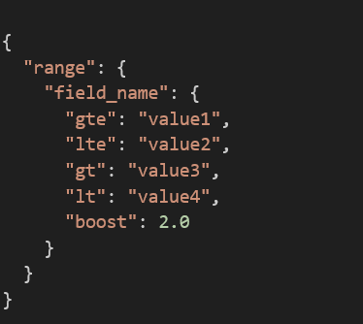
Term query
Range query

Slide 41
Must
Filter
Bool Query
Must
Not
Should

Slide 44

Clues available from the thief
Connection Node
Coordinating Node
Master Node
Ingest Node
Data Node
Machine Learning Node

